Slide 1

Becoming a Thought Leader in your Practice Area

Slide 2

What is a Thought Leader?
Subject-matter expert
Trusted source of information
The go-to expert in a field
Provider of unique insights and information
Connected and immersed

Slide 3
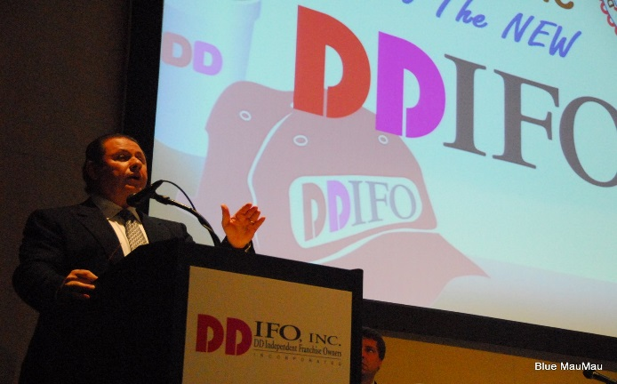
Examples of Thought Leaders
BoardroomPR in the legal industry
David Markus in criminal law
Becker and Poliakoff in condominium law
Robert Zarco in franchise law

Slide 4

Why is Thought Leadership important?
Reputation and brand
To be viewed as a source of information, opinion and expertise
Developing connections in the industry and maximizing your network
New business development

Slide 5

How to approach Thought Leadership
Where does it make sense?
Natural mapping of business and referrals
What are your passions?

Slide 6

What are the channels of Thought Leadership?
Industry involvement
Committees
Boards
Bar associations and related organizations
Attending events
Getting published
Articles
Expert sourcing

Slide 7



CLEs and educational sessions for clients
Speaking engagements
Blogging
Joining LinkedIn groups
Starting your own group

Slide 8

Connecting the dots, how to convert a contact into a source for new business
The elevator speech – making sure they know what you do
As part of your eblasts on interesting cases or decisions, trade journal or newspaper articles, the attorneys may want to connect specific services the firm offers to mitigate a risk
The ask

Slide 9
Questions to ask at a meeting, lunch or client visit
Did you read about the case………. Do you think you are prepared…..
Have you audited your agreements lately?
Have you audited your IP lately?
Are there any vulnerabilities you feel you have that we may assist with?
Are you interested in having us deliver an in-house CLE or seminar on software licensing agreements—best practices, Security risks and liability issues with your clients, how not to infringe on others’ IP with your website and social media

Slide 10

Thought Leadership Planning
Target Industry- Medical Devices
Organizations
Florida Medical Manufacturers Consortium
Medical Device Manufacturers Association
Medical Imaging and Technology Alliance
Even more in-depth options
American Orthotic and Prosthetic Association
Contact Lens Manufacturers Association
Hearing Industries Association
Publications
Medical Device and Diagnostic Industry
Medical Design Technology
Medical Design Briefs
Medical Device Summit
Today’s Medical Developments (TMD)

Slide 11

Target Industry- Pharmaceuticals
Organizations
BioFlorida
Pharmaceutical Research and Manufacturers of America
Consumer Healthcare Products Association
Generic Pharmaceutical Association
National Pharmaceutical Organization
Publications
Pharmaceutical Executive
Pharma World
Pharmaceutical Compliance Monitor

Slide 12
Target industry- Technology
Organizations
South Florida Technology Alliance
CompTIA
Florida Technology Council
Enterprise Florida
eMerge Americas
Publications
CIO Magazine
ComputerWorld
InfoWorld
Industry-specific tech sections and publications

